Slide 1
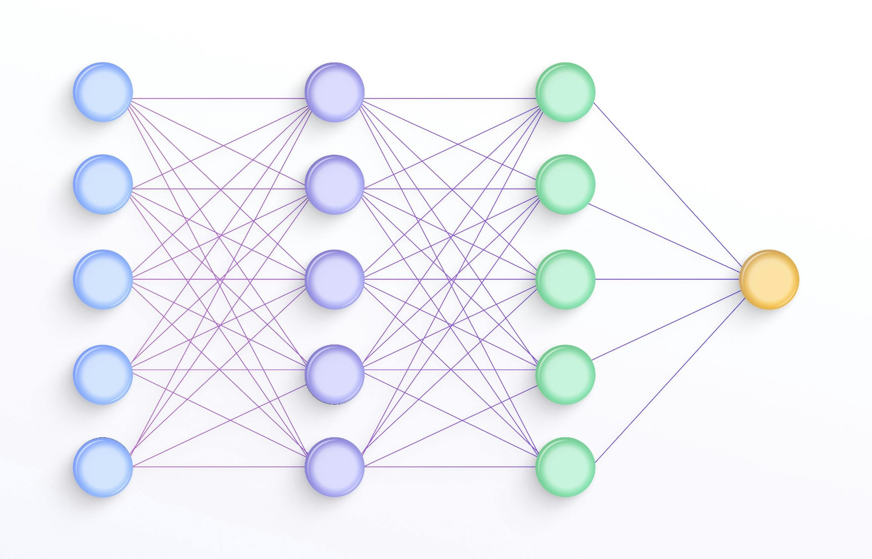
Image Classification Using Convolutional Neural Networks
Image classification is a fundamental task in computer vision that involves assigning a label or category to an image. Convolutional Neural Networks (CNNs) have proven to be highly effective in tackling this challenge.

Slide 2
Team Members :
Sr. No | Name | Roll Number | Email Id
1. | Om Ambalkar | 381003 | om.22210200@viit.ac.in
2. | Mrinmayee Deshpande | 381014 | mrinmayee.22210087@viit.ac.in
3 | Dipali Gangarde | 381020 | dipali.22210638@viit.ac.in
Guided By: Dr. Anuradha Yenkikar Ma’am

Slide 3
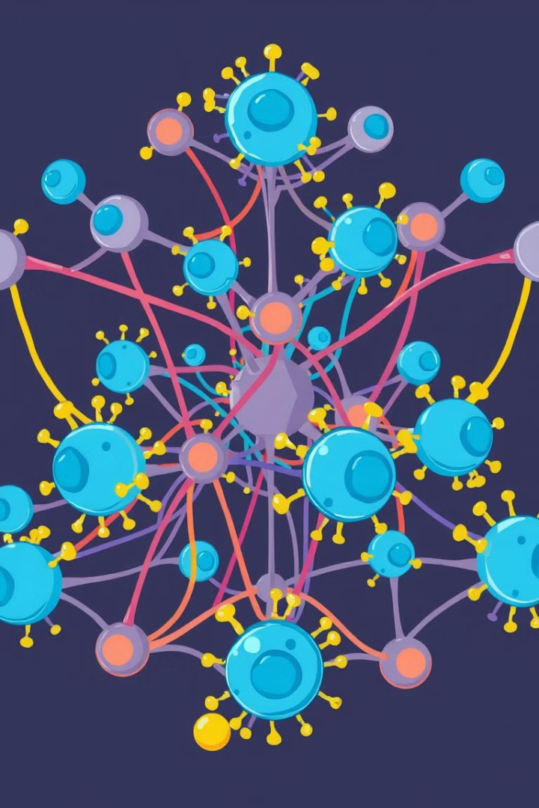
Convolutional Neural Networks (CNNs)
CNNs are a type of deep learning model designed to analyze images. They are specifically structured to process visual information through convolutional layers, which extract features like edges, textures, and shapes.
1
Feature Extraction
Convolutional layers apply filters to the image, extracting features at different scales.
2
Pooling
Pooling layers reduce the spatial dimensions of the feature maps, making the model more efficient.
3
Classification
Fully connected layers take the extracted features and classify the image into predefined categories.

Slide 4
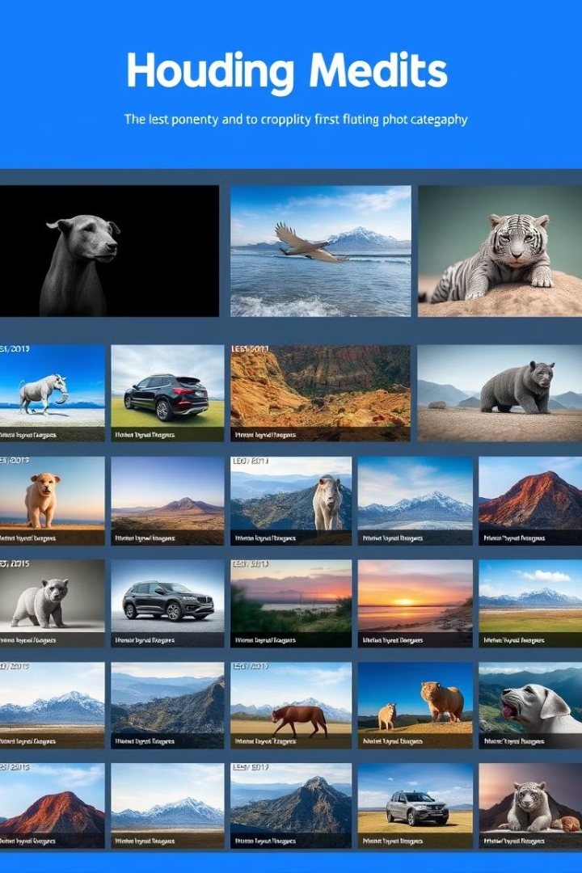
Preparing the Dataset
The first step in image classification is gathering a dataset of images. The dataset needs to be diverse and representative of the classes you want to classify. You'll need to label each image with its corresponding category.
1
Data Collection
Gather a collection of images that represent the different classes you want to classify. Ensure the dataset is diverse and representative.
2
Data Labeling
Assign a specific label or category to each image in your dataset. The accuracy of your model depends on the quality of labeling.
3
Data Preprocessing
Prepare your data for the CNN model by resizing images, standardizing pixel values, and possibly augmenting the data to improve model robustness.

Slide 5
Designing the CNN Architecture
The architecture of your CNN model is crucial for its performance. You'll need to design a network with appropriate layers and connections to effectively extract features and make accurate predictions.
Convolutional Layers
Pooling Layers
Fully Connected Layers
Apply filters to the input image, extracting features like edges, textures, and shapes. Use various filter sizes and strides.
Downsize the feature maps, reducing computational complexity and making the model more robust to small variations in the input image.
Connect all neurons in a previous layer to all neurons in the next layer. These layers are used for classification, combining extracted features into predictions.

Slide 6
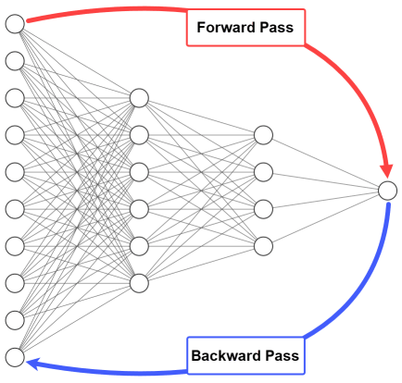



Training the CNN Model
Once you've designed your CNN architecture, you'll need to train the model using your labeled dataset. The training process involves feeding the model images and adjusting its parameters to minimize errors.
Forward Pass
Input an image to the model, and calculate the output prediction.
Loss Calculation
Calculate the difference between the model's prediction and the actual label.
Backward Propagation
Adjust the model's weights and biases to minimize the loss function.

Slide 7
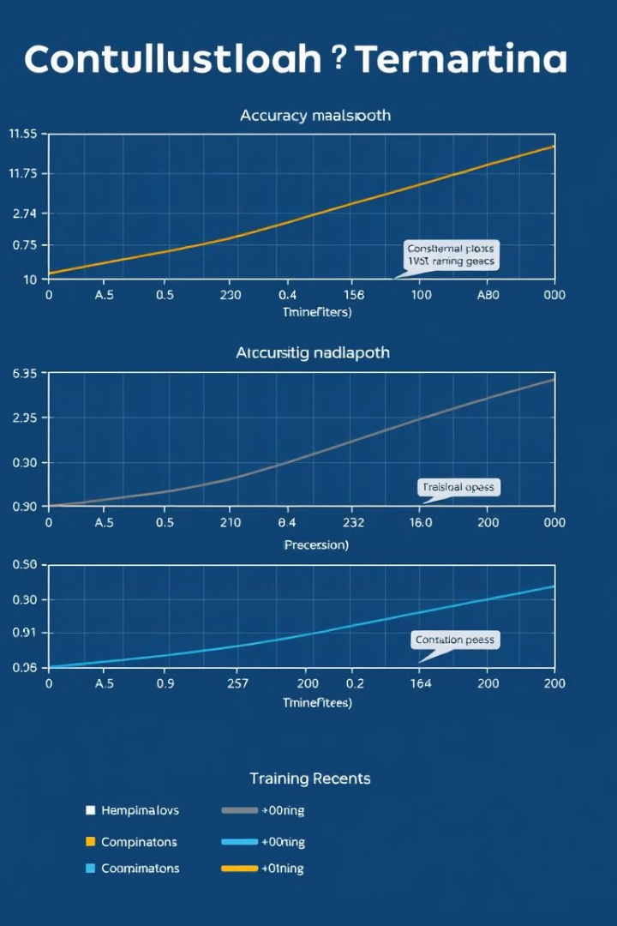
Evaluating the Model Performance
After training the model, it's essential to evaluate its performance on unseen data. This helps determine how well the model generalizes to new images it has not encountered during training.
Metric
Description
Accuracy
The percentage of correctly classified images.
Precision
The ability to correctly classify positive examples.
Recall
The ability to correctly identify all positive examples.
F1-Score
A balance between precision and recall.

Slide 8

Improving the Model Accuracy
If your model's performance is not satisfactory, you can try various techniques to improve its accuracy. These techniques aim to enhance the model's ability to generalize to new data.
Hyperparameter Tuning
Data Augmentation
Ensemble Methods
Experiment with different values for parameters like learning rate, batch size, and number of layers.
Create new variations of existing images by applying transformations like rotations, flips, and color adjustments.
Combine multiple CNN models to make predictions, averaging their outputs for improved accuracy.

Slide 9
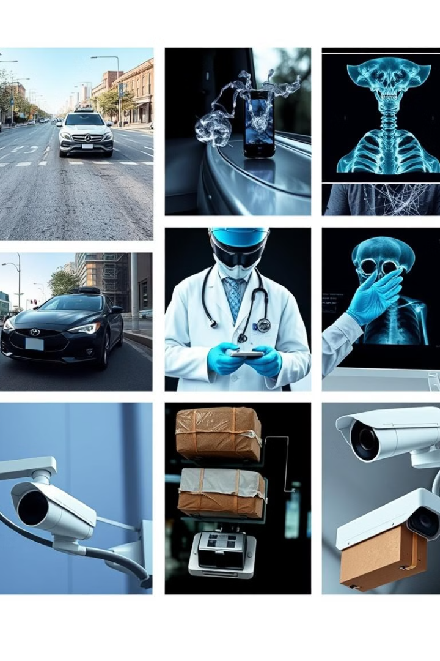




Deployment &
Real-World Applications
Once you have a well-performing CNN model, you can deploy it for real-world applications. Image classification is widely used in various industries, from healthcare to automotive.
Autonomous Vehicles
Medical Imaging
Object detection and recognition
for safe navigation.
Disease diagnosis and
tumor detection.
Security Systems
Image Search
Facial recognition and intrusion
detection.
Visual search engines for
finding similar images.

Slide 10
Thank
You..!!

